Slide 1
Topics
Review on Last week
NoSQL
MongoDb

Slide 2
Review
How do you assign an error code to a user defined exception?
Pragma exception_init(exname, number)
How do you invoke the user defined exception in your executable area?
Raise exname;
What is a more controlled way you can handle a user defined exception?
EXCEPTION
WHEN exname
THEN

Slide 3
Review
Where can user defined functions appear? – udf()
In the column list, where, order by and group by clauses of a Select statement
In the Where clause of an Update statement
In the Values clause of an Insert statement

Slide 4
Review
What is a Trigger?
Actions that take place before or after an event
Update, Insert, Delete, or Read
Can be used to enforce complex business rules
Used to audit sensitive data

Slide 5
Relational Database Alternatives
NoSQL
NewSQL
Multi Model

Slide 6
Wikipedia Definitions
NoSQL – “Not only SQL” – A NoSQL database provides a mechanism for storage and retrieval of data that is modeled in means other than the tabular relations used in relational databases.
NewSQL - is a class of relational database management systems that seek to provide the scalability of NoSQL systems for online transaction processing workloads while maintaining the ACID guarantees of a traditional database system
Multi-model - Most database management systems are organized around a single data model that determines how data can be organized, stored, and manipulated. In contrast, a multi-model database is designed to support multiple data models against a single, integrated backend

Slide 7
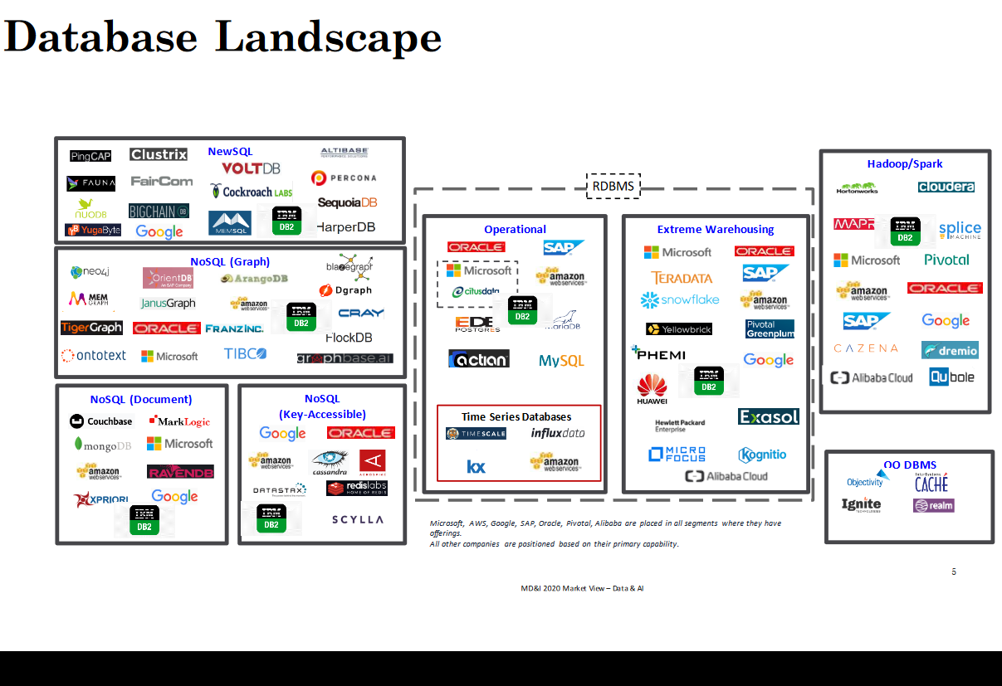

Slide 8
NoSQL
A class of database management systems that depart from traditional RDBMSs
Does not use SQL as the primary query language
Is “schema-less”
No rigid schema enforced by the DBMS
Programmer-friendly for adding fields to a document
Might not guarantee full ACID behavior
Often has a distributed, fault-tolerant, elastic architecture
Highly optimized for retrieve and append operations over great quantities of data

Slide 9
ACID Transactions
Atomicity - all operations in a transaction succeed or are all rolled back
Consistency - after transactions are complete, the database remains consistent
Isolation - transactions are executed without interfering with other transactions
Durability - after transactions are completed, changes will be permanent

Slide 10
MongoDB
What is MongoDB?
MongoDB is a document-oriented database and differs from a relational one.
It scales up easier compared to a relational database.
MongoDB is a powerful, flexible, and scalable general-purpose database.
It provides the following features:
Indexing
Aggregations
File Storage
Special collection types

Slide 11
MongoDB Ease of Use
The concept of a row is replaced with a document which is more flexible.
By using documents and arrays, complex hierarchical relationships can be represented with a single record.
MongoDB is schemaless.
There is not predefined schema.
The type and size of document’s keys and values can be variable.
Add or remove fields is easier.
Different models can be chosen

Slide 12
MongoDB Easy Scaling
As data grows at an incredible pace, the databases need to scale up.
To scale:
Large machines can be used to scale up
Expensive
There is physical limit, more powerful machine may not exist.
Partitioning data across more machines can help scale out
More storage space by adding servers and computers to your cluster
Cheaper
But difficult to manage thousands of machines
MongoDB as a document-oriented model scales out easier by splitting data across multiple servers.

Slide 13
MongoDB Basic Concepts
Document
A document is the basic unit of data
A document is equivalent to a row in a relational
database
Collection
a collection can be considered as a table but with a
dynamic schema
One MongoDB instance can host multiple tables.

Slide 14
Documents
Every document has a special key (Id)
The key of a document is unique within a collection
Example: {"greeting" : "Hello, world!"}
Key: “greeting”
Value: “hello, world!”
A document can contain multiple key/value pairs:
{"greeting" : "Hello, world!", "foo" : 3}
Key: “greeting” and value: “hello, world!”
Key: “foo” and value: 3
As you see the type of these two values are different. One is integer and the other one is string.

Slide 15
Document Key
Document Key
The type of a key is string (UTF-8 characters).
The key cannot be the null terminator ‘\0’.
Do not include $ in a key.
MongoDB is type-sensitive and case-sensitive:
{"foo" : 3}
{"foo" : "3"}
The above documents are distinct.
The following documents are distinct as well
{"foo" : 3}
{"Foo" : 3}
In Oracle the column empid and Empid are the same
The columns are not case-sensitive

Slide 16
Documents
Duplicate Keys
A document cannot contain duplicate keys:
{"greeting" : "Hello, world!", "greeting" : "Hello, MongoDB!“}
The above document is not a legal document because it has duplicate keys.
Will cause an error
This is similar to having a unique primary key in a table in a relational database

Slide 17
Collections
A collection is a group of documents.
A collection in MongoDB can be considered as a
table in a relational database.
The collection has a dynamic schema.
Documents within a collection can have different schemas.
{"greeting" : "Hello, world!"}
{"foo" : 5}
The values have different types.
Two different documents inside the same collection
A document can be in any collection.
Can’t do the same thing with rows, columns tables in a relational database

Slide 18
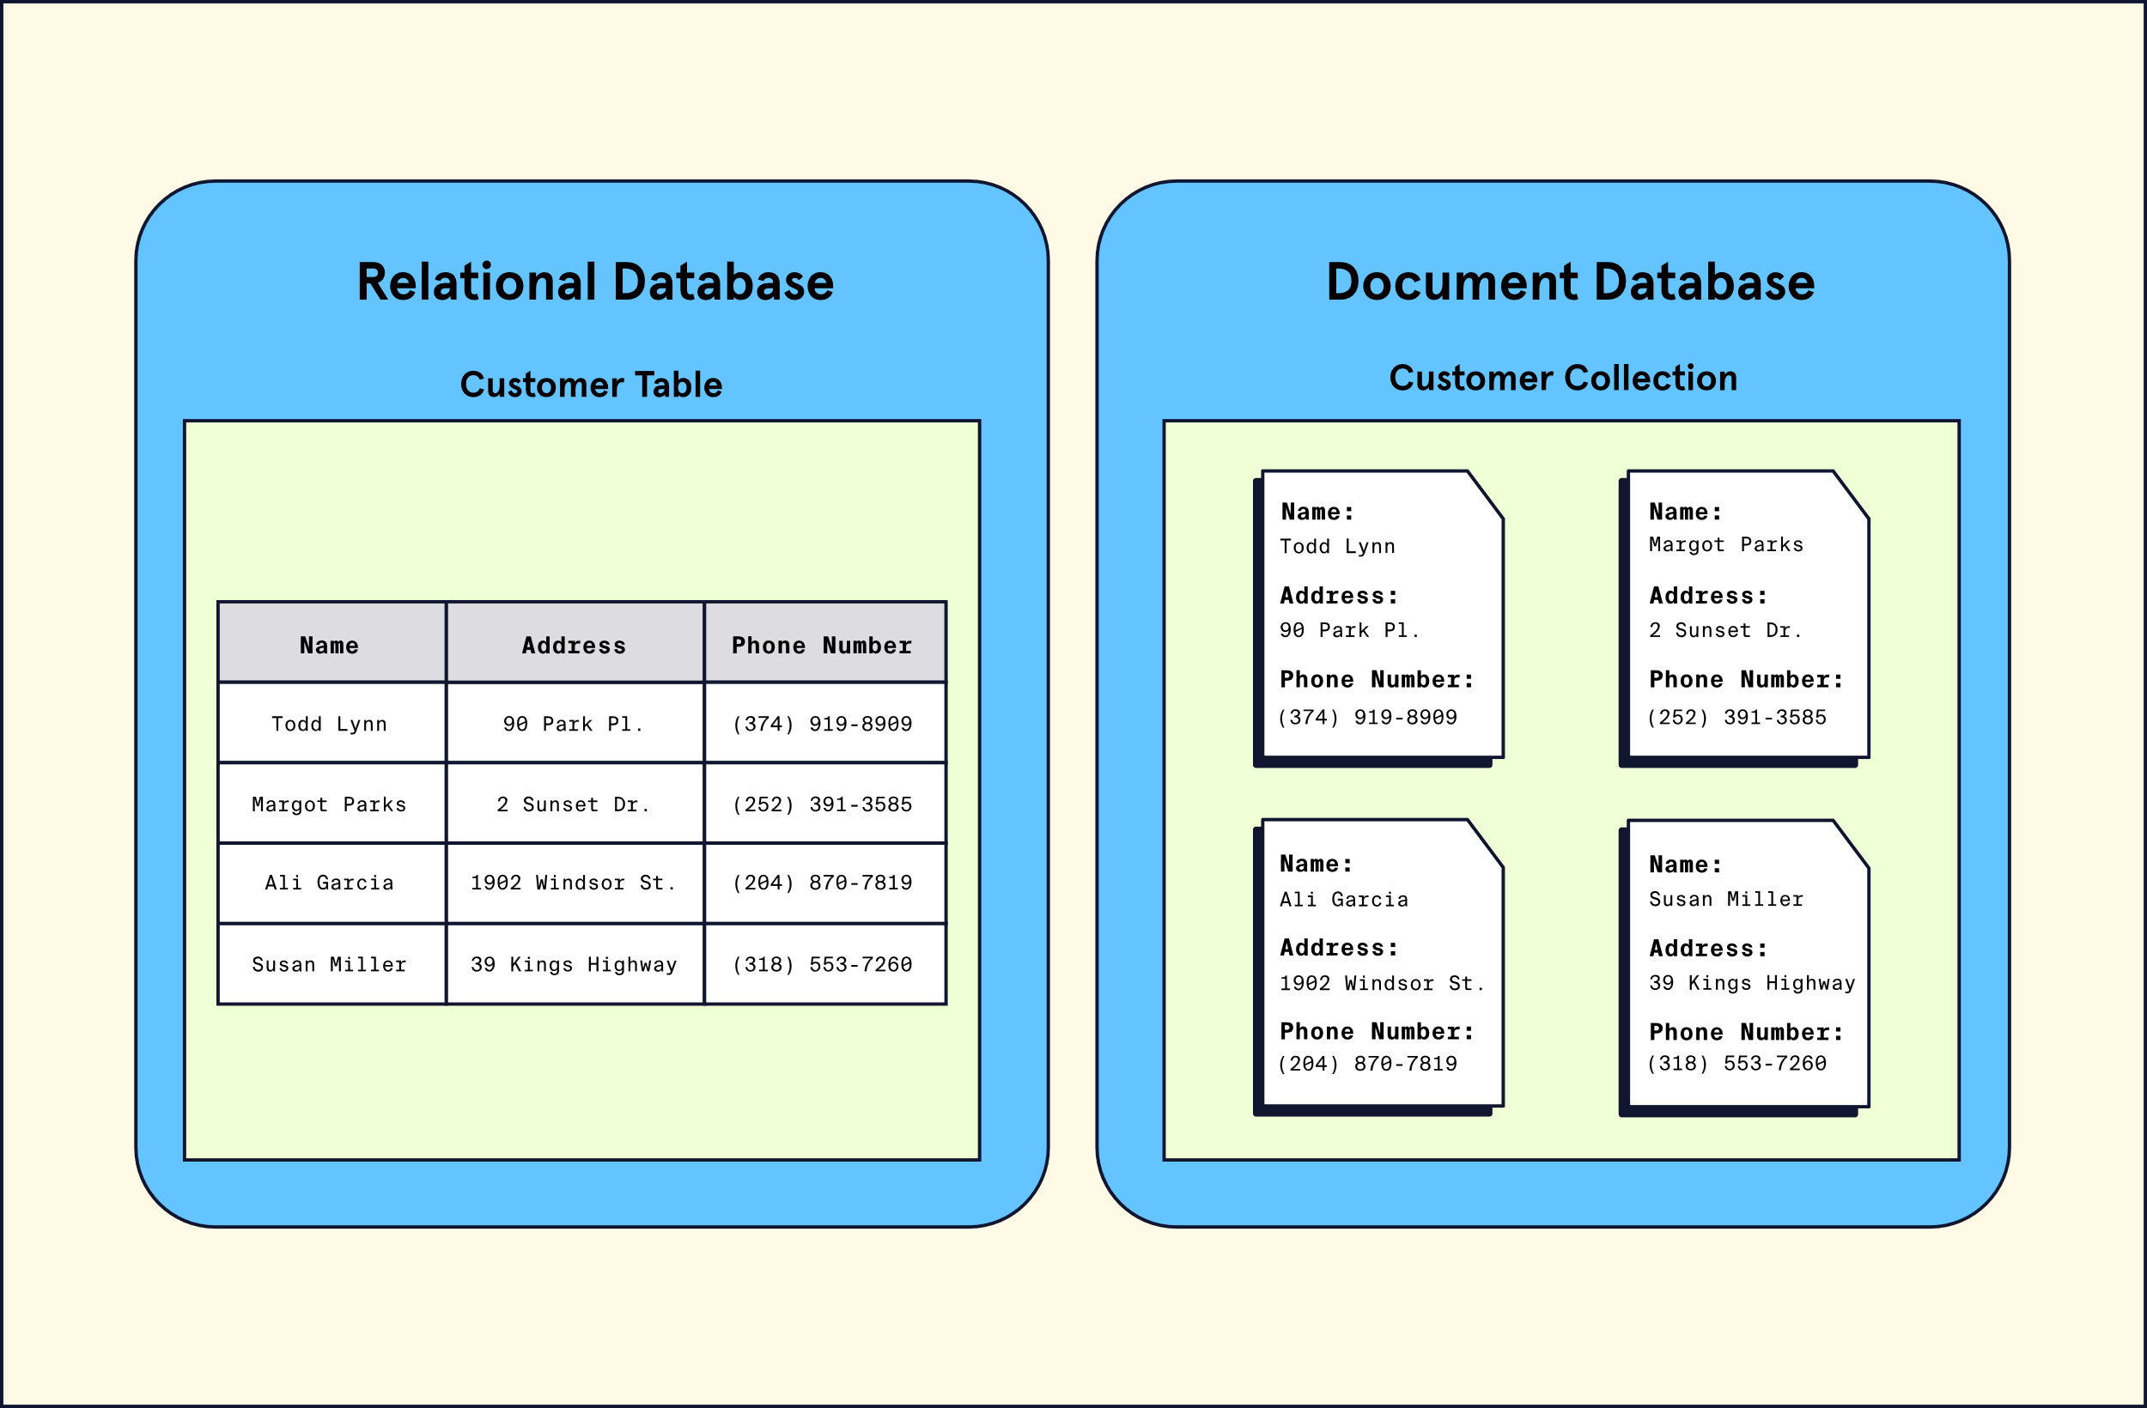

Slide 19
Collection Name
A collection is identified by its name.
The name cannot
Be an empty string “ “
contain the null terminator character ‘\0’
start with a reserved prefix such as system.
Include the reserved character $
$ is reserved for functions

Slide 20
Sub-collections
To organize a collection, sub-collections can be used separated by ‘.’ character.
Example:
Collection blog has two subcollections:
blog.posts
blog.authors

Slide 21
Why Collections
Advantages
To make sure a query returns documents of a certain type.
We may have documents for
Blog posts
Author data
Efficiency
Data Locality
Indexing

Slide 22
Database
In MongoDB, a database is a group of collections.
A single instance MongoDB can host several databases.
Each database stores a separate file.
A database stores data related to a single application.
Each database is identified by name.
The name cannot include:
Space character “ “
Special characters:
/, \, ., ", *, <, >, :, |, ?, $, (a single space), or \0
Names are case-sensitive.
Names cannot be more than 64 bytes.
A qualified collection name (namespace)
database.collection.subcollection: cms.blog.posts

Slide 23
Reserved Database Names
Admin
This database is the root database.
Users added to the admin database have all permissions to all
databases.
Only admin users are authorized to run certain server
commands.
Local
This database stores any local connections on a single server.
Config
A config server stores the clusters’ metadata.

Slide 24
Drop Collections
If a collection is dropped, all documents in the collection will be removed.
Example: insert multiple documents into tester collection
> for (var i = 0; i < 1000000; i++) { ... db.tester.insert({"foo": "bar", "baz": i, "z": 10 - i}) ... }
> db.tester.drop();
This command deletes the db.tester collection.

Slide 25
MongoDB Shell
MongoDB shell is a full-featured JavaScript interpreter. • You can run JavaScript programs in the shell.
> x = 200
200
> x / 5;
40
We can use the standard JavaScript libraries:
> "Hello, World!".replace("World", "MongoDB"); Hello, MongoDB!
We can define JavaScript functions:

Slide 26
JavaScript function
> function factorial (n) { ... if (n <= 1) return 1; ... return n * factorial(n - 1); ... } > factorial(5); 120 lo, MongoDB!

Slide 27
MongoDB Demonstration
Create & Drop Database
Create & Remove Document
Query

Slide 28
MongoDB Demonstration
Create a Database
MongoDB creates a database (if it does not exist) when you insert the first document into your database.
> Use myNewDb
> db.newCollection.insertOne(“field” : “value”)
Both myNewDb and newCollection will be created.

Slide 29
MongoDB Demonstration
Drop a Database
db.dropDatabase()
removes the current database and all data inside the database.

Slide 30
MongoDB Demonstration
Create & Remove a Document
Insert
This function adds a document to a collection.
Assume we want to create the following document:
{"title" : "My Blog Post",
... "content" : "Here's my blog post.",
... "date" : new Date()}
The insert function is used to save this document to the blog collection.
db.blog.insert({"title" : "My Blog Post",
... "content" : "Here's my blog post.",
... "date" : new Date()})
The above code adds an "_id" key to the document and stores it in MongoDB.

Slide 31
MongoDB Demonstration
Variables
A document can be stored to a variable:
> post = {"title" : "My Blog Post",
... "content" : "Here's my blog post.",
... "date" : new Date()}
{ "title" : "My Blog Post",
"content" : "Here's my blog post.",
"date" : ISODate("2012-08-24T21:12:09.982Z") }
The document can be inserted to the blog collection by using the post variable:
> db.blog.insert(post)

Slide 32
MongoDB Demonstration
BULK INSERT
The batch insert can be used to insert multiple documents into a collection by passing an array of documents.
Example 1:
> db.foo.insert([{"_id" : 0}, {"_id" : 1}, {"_id" : 2}])
> db.foo.find()
{ "_id" : 0 }
{ "_id" : 1 }
{ "_id" : 2 }
We will use db.collectionName.insertMany([

Slide 33
MongoDB Demonstration
BULK INSERT
Example 2:
> db.foo.insert([{"_id" : 0}, {"_id" : 1}, {"_id" : 1}, {"_id" : 2}])
In this example, the first two documents will be inserted.
The insertion of the last two fails because you cannot insert two documents with the same “_id”.
To ignore errors and insert the rest of the batch the continueOnError option can be used to insert documents after the failure.

Slide 34
MongoDB Demonstration
InsertOne
The function insertOne adds one document to a collection.
db.blog.insertOne({"title" : "My Blog Post",
... "content" : "Here's my blog post.",
... "date" : new Date()})

Slide 35
MongoDB Demonstration
insertMany
To insert multiple documents, the insertMany function can be used. The function receives an array of documents.
> db.blog.insertMany([
… {"title" : "My Blog Post", "content" : "Here's my blog post."},
… {"title" : "New Post", "content" : "Here's the new blog post."},
… {"title" : "Public Post", "content" : "Here's the public post."},
] )

Slide 36
MongoDB Demonstration
Insert Validation
In an insert operation MongoDB
Checks the document’s basic structure
The size (must be less than 16 MB)
Adds an “_id” field if one does not exists
Invalid data can be easily inserted.
In insert operation, if the given collection does not exist, It will be created

Slide 37
MongoDB Demonstration
Remove
The remove function deletes documents.
Example 1: > db.foo.remove()
The above command removes all documents from the blog collection.
Example 2: > db.mailing.list.remove({"opt-out" : true})
This command removes all documents from mailing.list collection if their value of “opt-out” is true.
The deleted data cannot be recovered after it is removed.
We will use db.collectionName.deleteMany({});

Slide 38
MongoDB Demonstration
Querying a Document
ad-hoc queries using find or findOne
Query for
Range selection
Set inclusion
Inequalities
Cursors

Slide 39
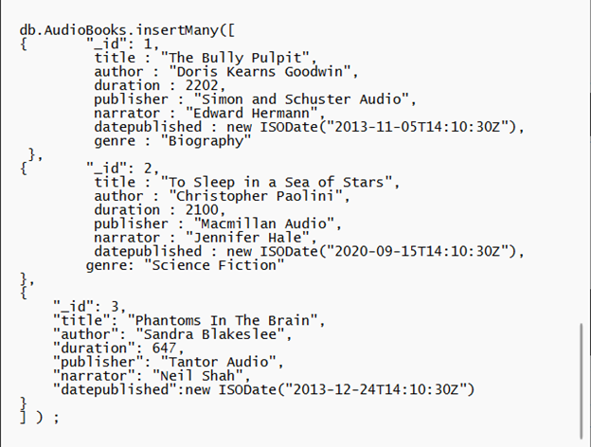
InsertMany

Slide 40
MongoDB Demonstration
Find
The find function is called to query and see documents in a collection. It returns a subset of documents.
To see documents in blog collection:
db.blog.find() Or
Db.blog.find({})
The following is the result of calling find function since we have only one document in the blog collection:
{ "_id" : ObjectId("5037ee4a1084eb3ffeef7228"),
"title" : "My Blog Post",
"content" : "Here's my blog post.",
"date" : ISODate("2012-08-24T21:12:09.982Z") }

Slide 41
MongoDB Demonstration
FindOne
The findOne is used to read and see one document from a collection.
Example:
db.blog.findOne()
{
"_id" : ObjectId("5037ee4a1084eb3ffeef7228"),
"title" : "My Blog Post",
"content" : "Here's my blog post.",
"date" : ISODate("2012-08-24T21:12:09.982Z")
}

Slide 42
MongoDB Demonstration
Query with Key/Value Pairs
We can add key/value pairs to restrict the search.
Members match members
Booleans match Booleans
Strings match strings
Find all documents where the value of age is 20:
> db.users.find({"age" : 20})
search for documents where the username is “joe”
> db.users.find({"username" : "joe"}) •
To find documents with multiple conditons, more key/value pairs can be added. We want to find users where their age is 20 and the username is “joe”:
> db.users.find({"username" : "joe", "age" : 20})
To find items which are out of stock: > db.stock.find({"in_stock" : 0})

Slide 43
Lab
Lab 7 is an open ended lab. Get started with MongoDB, create a collection and documents of your choice.
The labs will be done on your pc’s or laptops and will require some installation
The labs will be demonstrated online since the schools machines are not set up for this new approach

Slide 44
